Slide 1
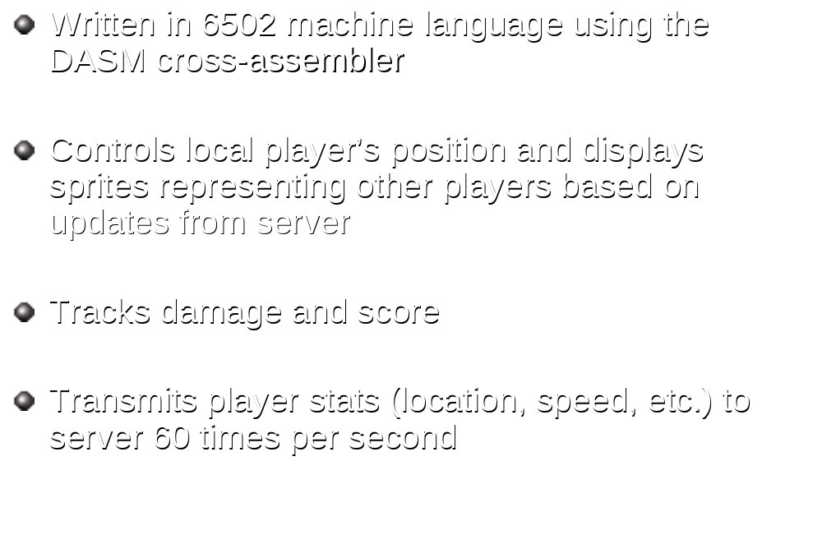
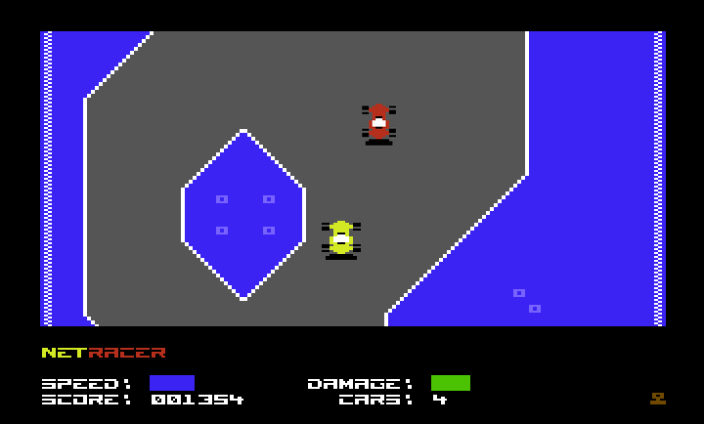
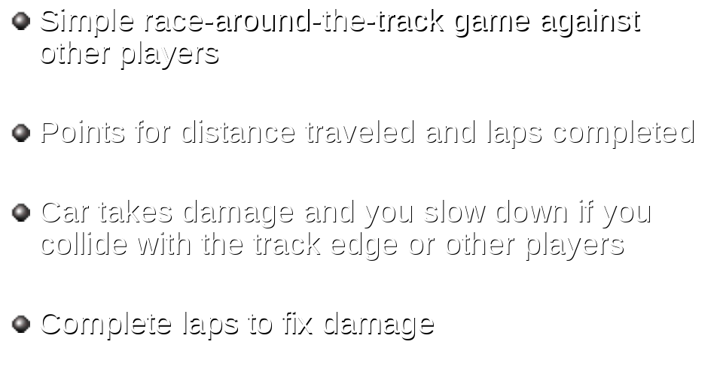
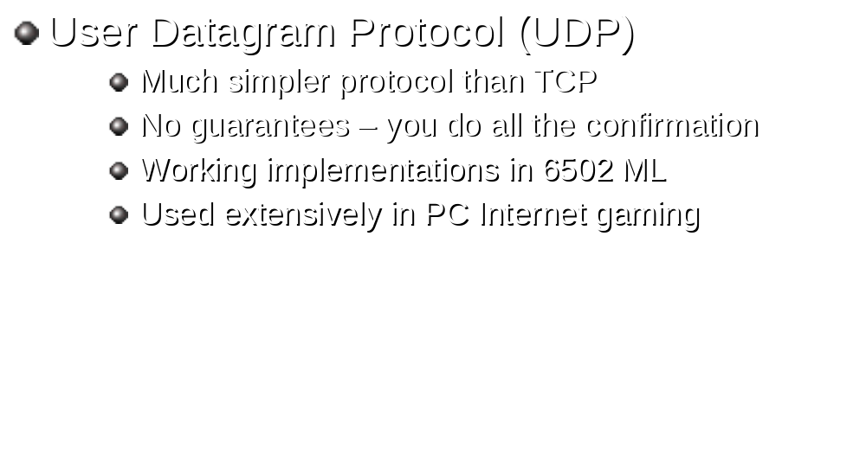
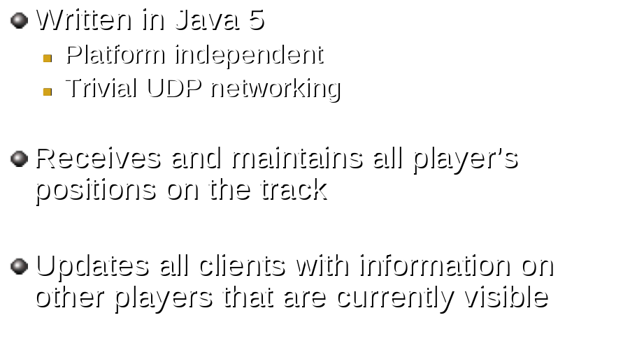
NetRacer
A real-time networked multiplayer action game for the
Commodore 64 with Ethernet cartridge!
Gameplay
Networking
Client
Commodore 64
(ML)
Commodore 64
(ML)
UDP
UDP
Commodore 64
(ML)
UDP
Server
(Java)
UDP
Commodore 64
(ML)
UDP
UDP
Commodore 64
(ML)
Commodore 64
(ML)
Server
Leif Bloomquist Robin Harbron & Lasse Öörni Oliver VieBrooks Raymond Lejuez Alexander Rotzsch Ian Colquhoun
Game Graphics code Networking code Graphics Music Server hosting

